Slide 1

Introduction to E-Commerce
E-commerce has transformed how businesses operate and consumers shop. It allows companies to reach a global audience, providing convenience and accessibility for buyers.

Slide 2
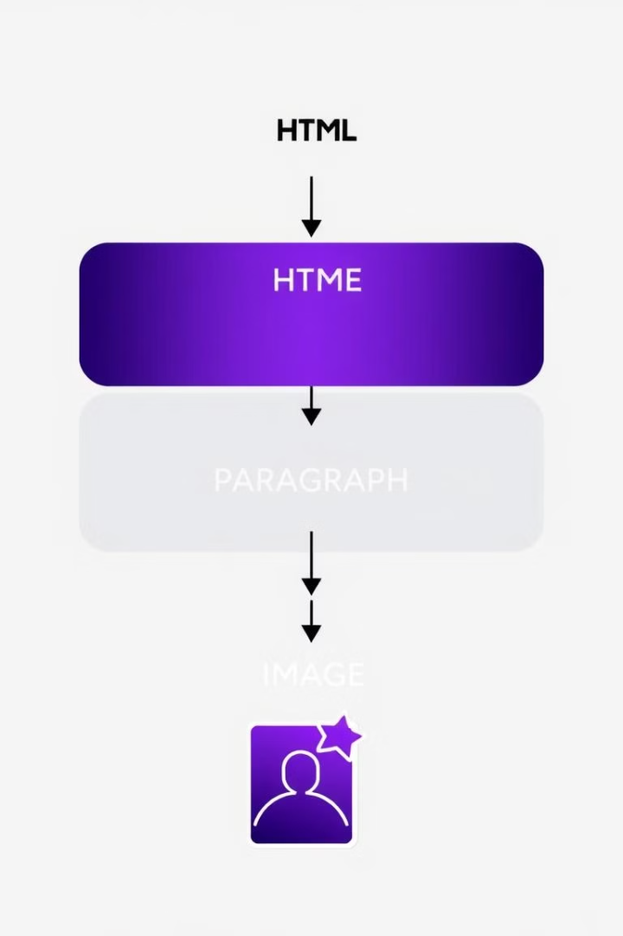
HTML Structure and key tags
1
Head
2
Body
Contains metadata about the page, not displayed on the page itself. Includes title, links to stylesheets, and scripts.
The visible content of the webpage, including text, images, and interactive elements.
3
Tags
Used to define elements and their content, providing structure and meaning to the HTML document.

Slide 3

Key HTML Elements Used
Element
Description
<div>
Divides the page into sections, allowing for easier styling and organization.
<img>
Displays images, essential for showcasing products and enhancing visual appeal.
<p>
Used for paragraphs, presenting product descriptions and other textual information.
<a>
Creates links to other pages or resources, allowing users to navigate and explore the site.

Slide 4
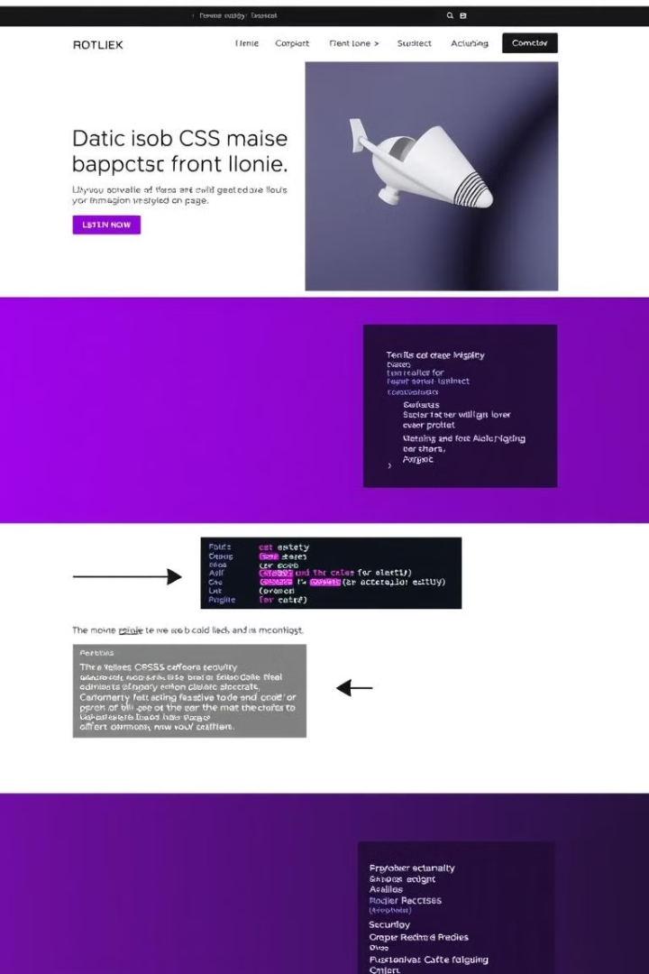
Introduction to CSS and Styling
1
Selectors
Target specific HTML elements to apply styles to, like classes, IDs, or element types.
2
Properties
Determine the style of the element, such as color, font size, background image, and margins.
3
Values
Specify the actual style to apply to the chosen property, like red, 16px, or url(image.jpg).

Slide 5
CSS in Action - styling key Element
Product Images
Headings
Descriptions
Using CSS, product images can be resized, framed, and displayed consistently throughout the website.
Font size, color, and alignment can be tailored to create visually appealing and clear headings.
CSS can enhance readability by adjusting font size, line height, and color to provide a pleasant reading experience.

Slide 10

Thank You
We hope this overview of E-commerce has been informative and insightful. Please feel free to ask any questions.

